Slide 1

<Web Design/>

Slide 2
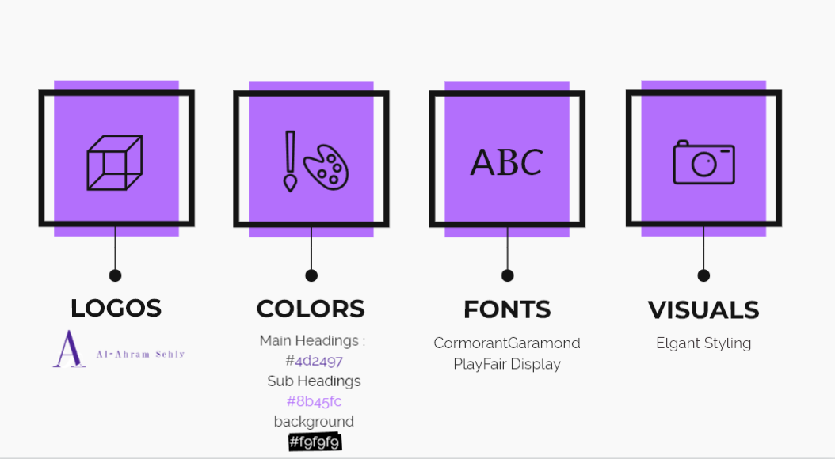
Brand Identity Guidelines
OverView
Home Page
Sign Up
About Us
Register
Cart
Data Base

Slide 3
UI/UX Guidelines For Elegant
OverView
Home Page
Shop
About Us
Register
Cart
Data Base
For luxury and elegance, based on thin serif typefaces, golden or pastel colors, and big high-quality images
Typography : Serif typefaces (especially in headings), light font weight, small body font size
Shadows : Usually no shadows
Border Radius : Usually no border-radius
White Space : Use negative Space

Slide 4
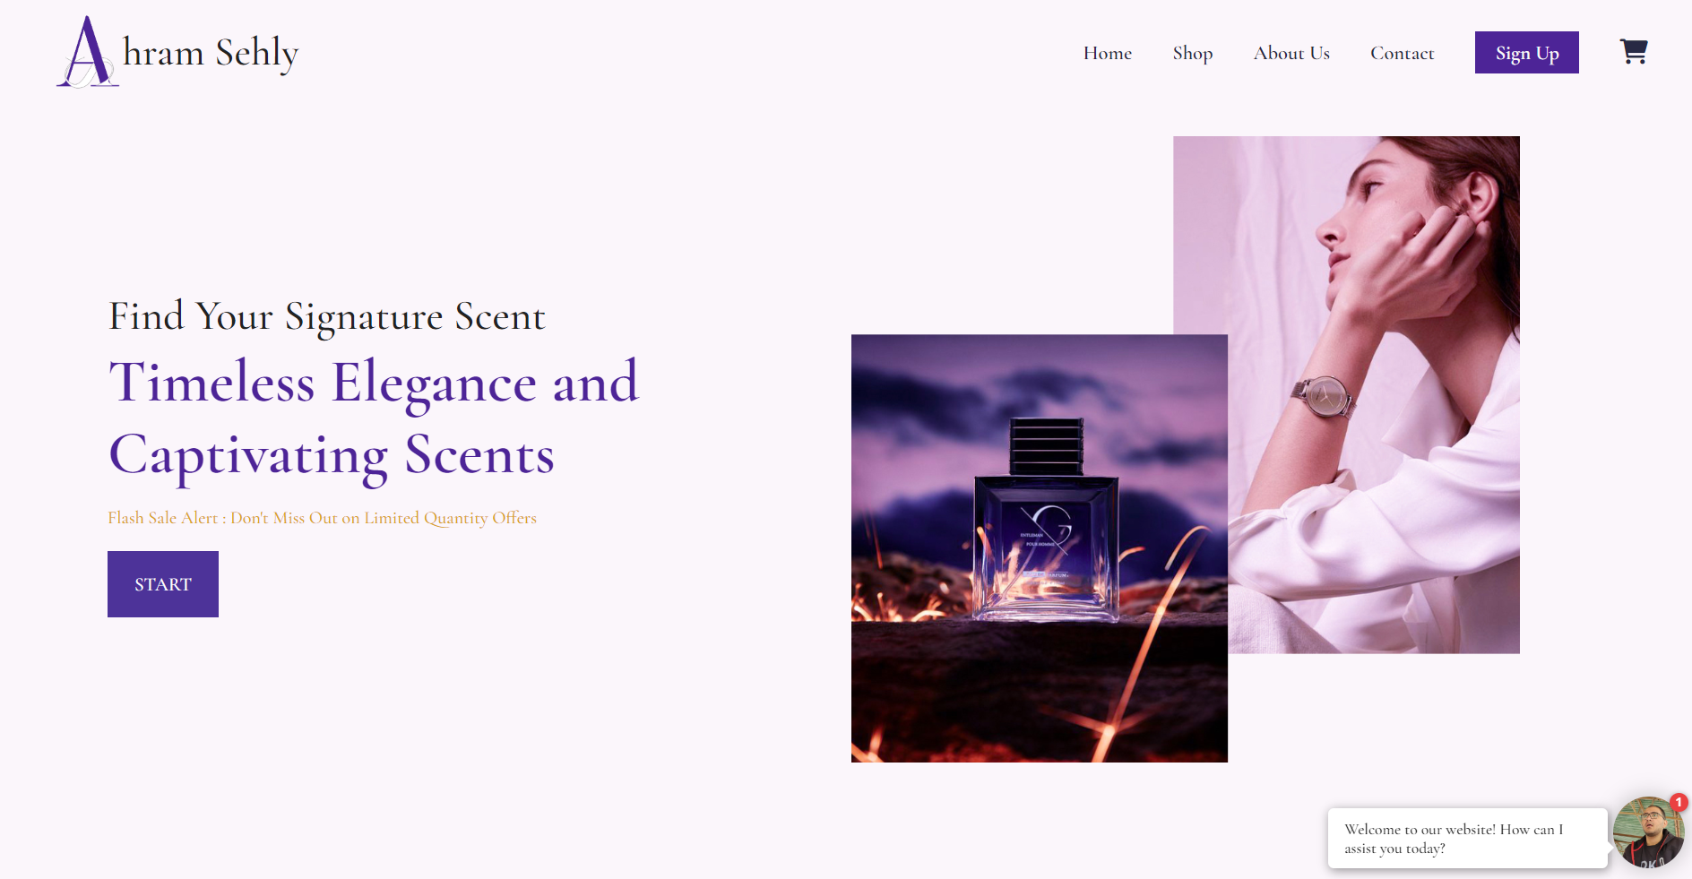
Overview
Home Page
Shop
About Us
Register
Cart
Data Base

Slide 5
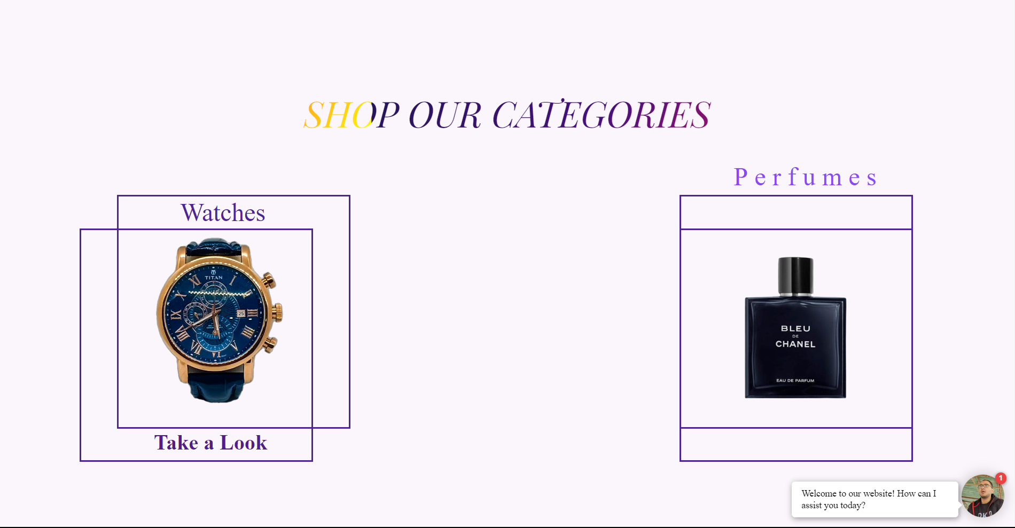
OverView
Home Page
Shop
About Us
Register
Cart
Data Base

Slide 6
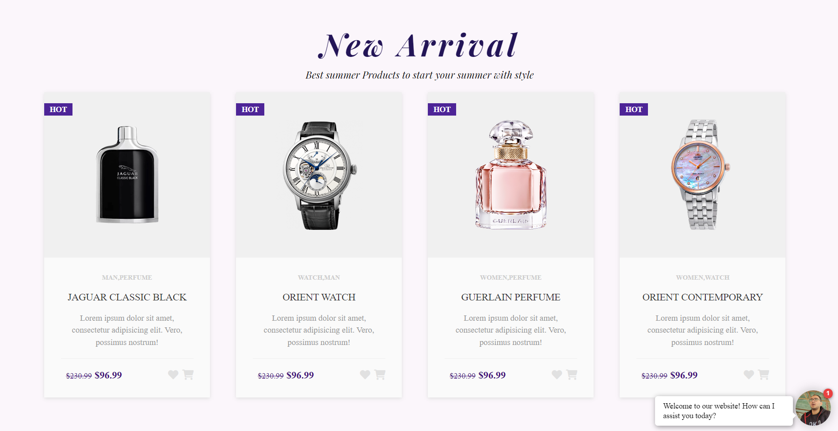
OverView
Home Page
Shop
About Us
Register
Cart
Data Base

Slide 7
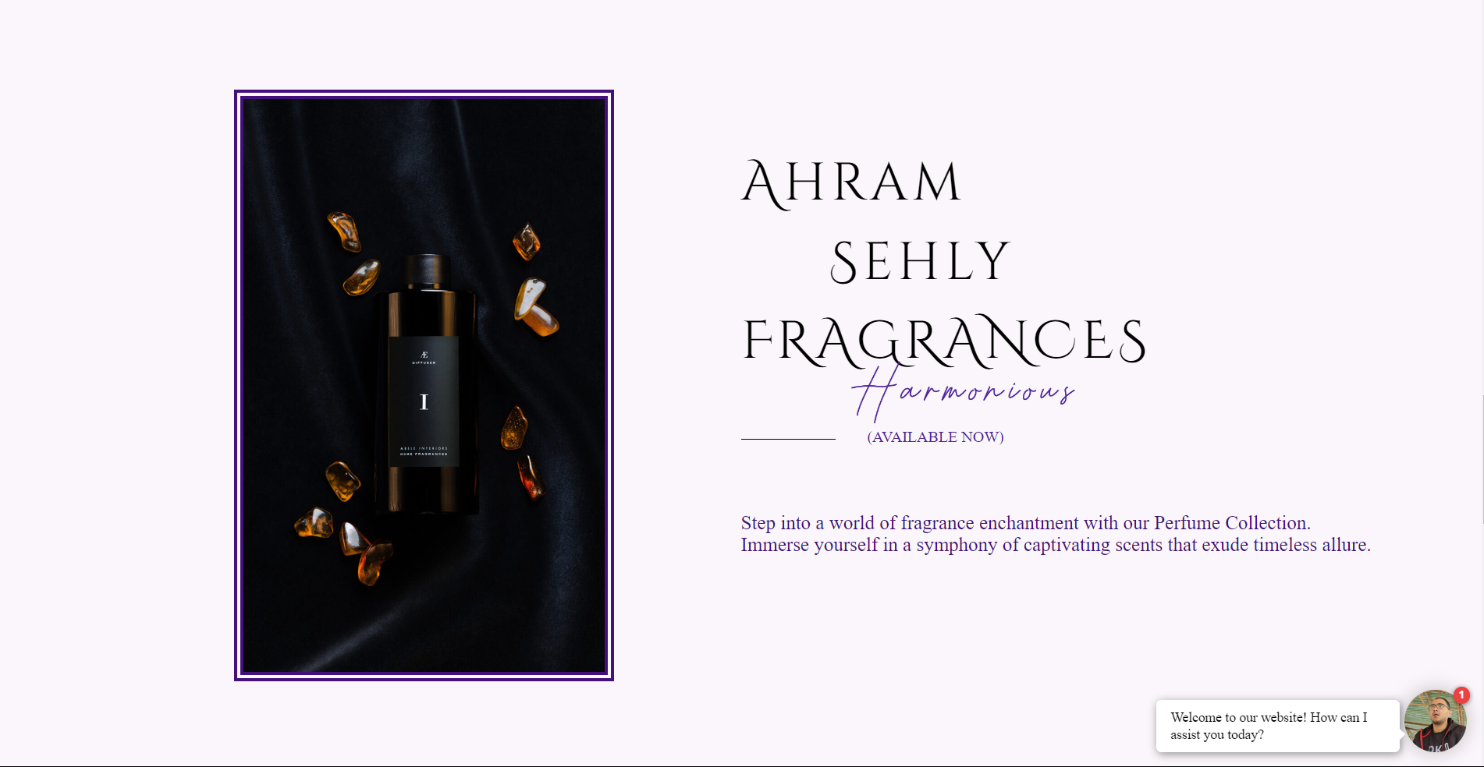
OverView
Home Page
Shop
About Us
Register
Cart
Data Base

Slide 8

Overview
Home Page
Shop
About Us
Register
Cart
Data Base

Slide 9
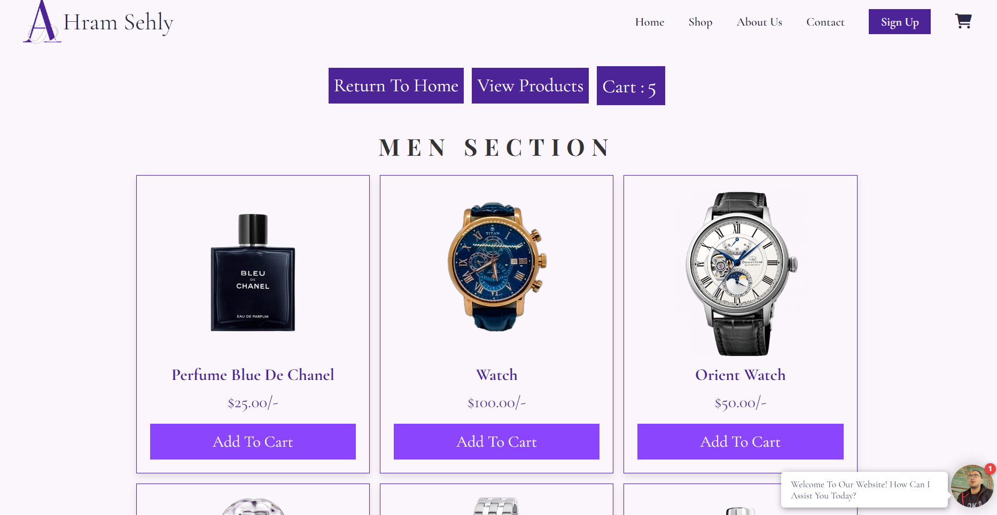
Overview
Home Page
Shop
About Us
Register
Account Page
Data Base

Slide 10

Overview
Home Page
Shop
About Us
Register
Cart
Data Base

Slide 11
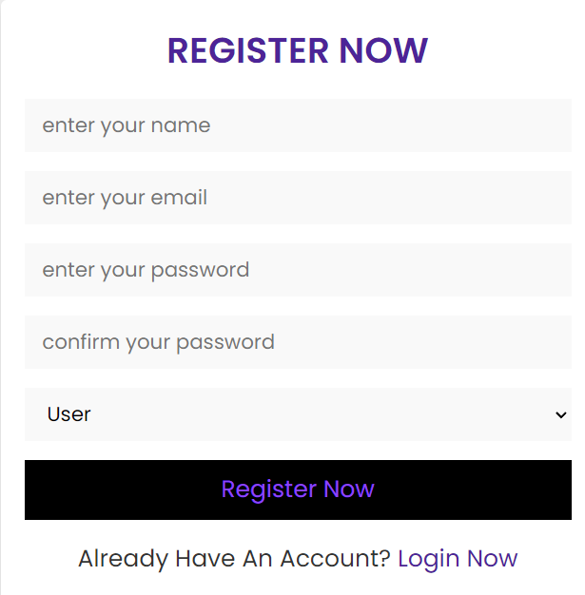
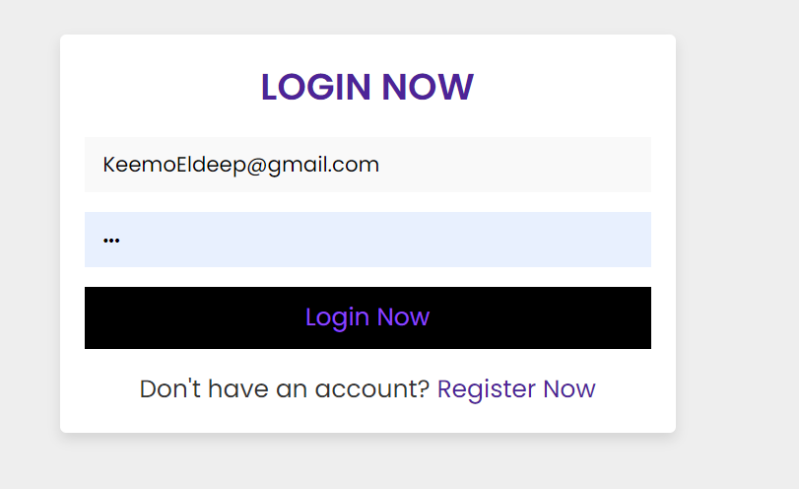
Contents
Home Page
Shop
About Us
Register
Cart
Data Base

Slide 12

Overview
Home Page
Shop
About Us
Register
Cart
Data Base

Slide 13
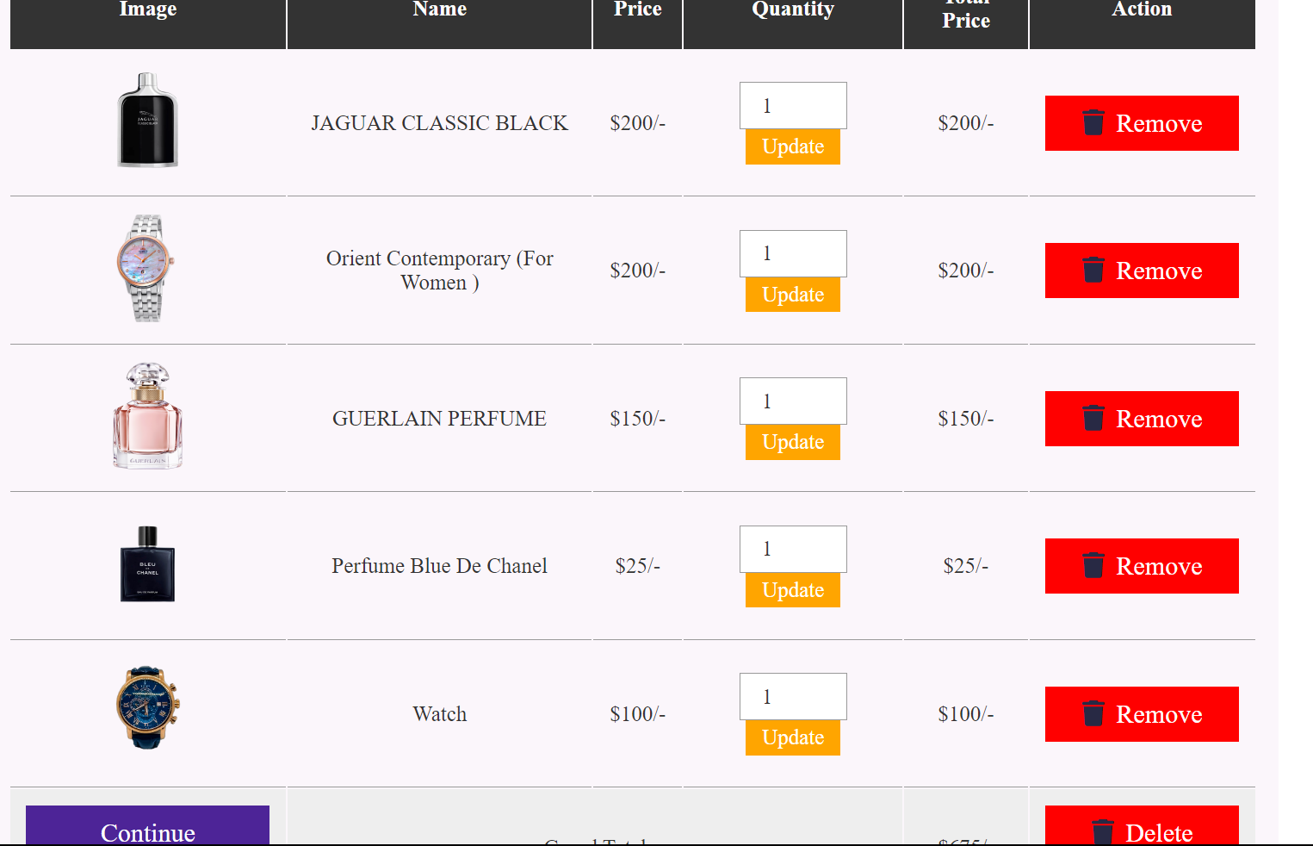
Home Page
Shop
About Us
Register
Cart
Data Base
Overview

Slide 14
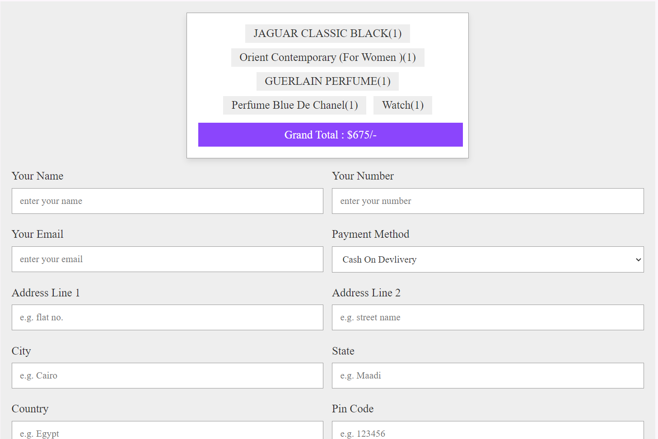
Overview
Home Page
Shop
About Us
Register
Cart
Data Base

Slide 15
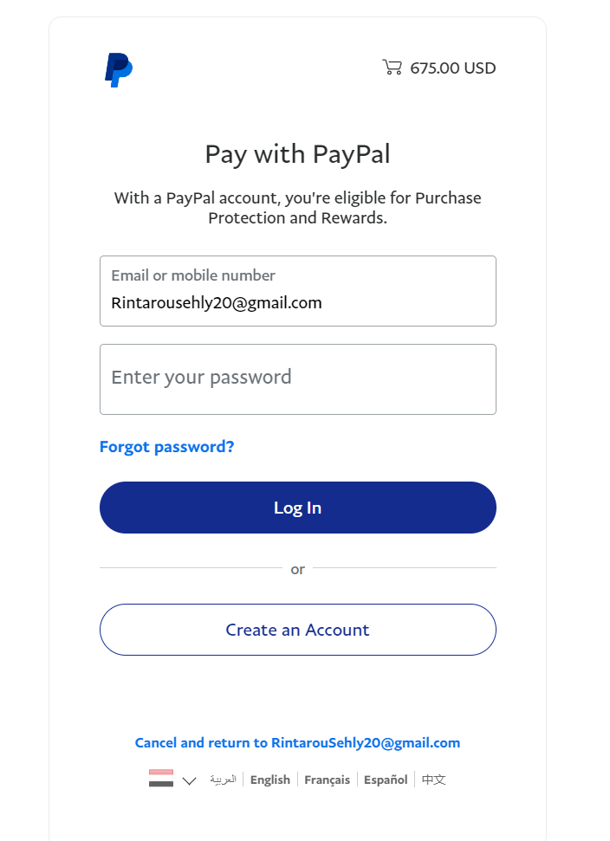
Overview
Home Page
Shop
About Us
Register
Cart
Data Base
PAYPAL API

Slide 16
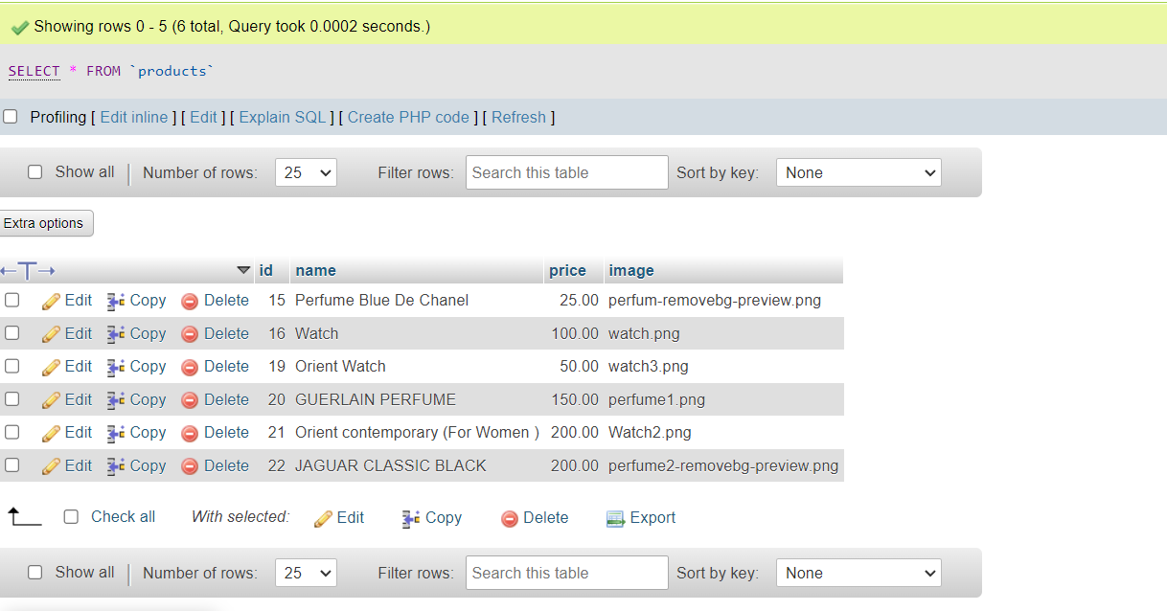
Overview
Home Page
Shop
About Us
Register
Cart
Data Base
Products
Table Structure

Slide 17
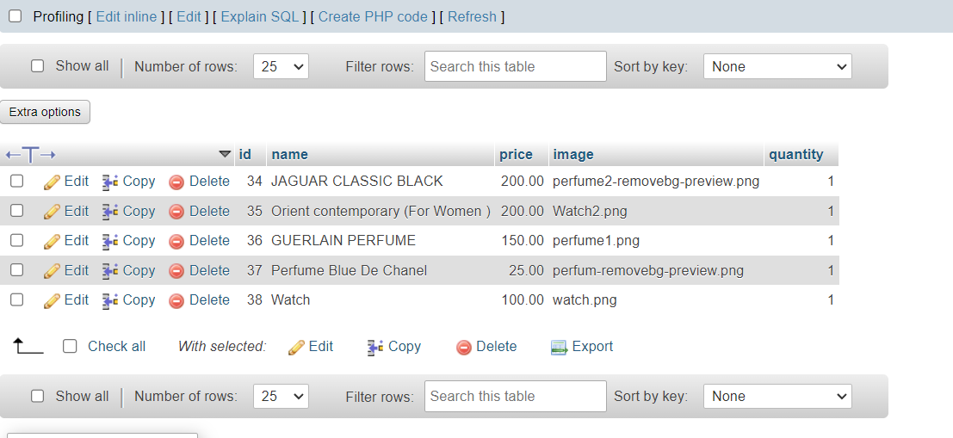
Overview
Home Page
Shop
About Us
Movie Page
Cart
Data Base
Cart

Slide 18
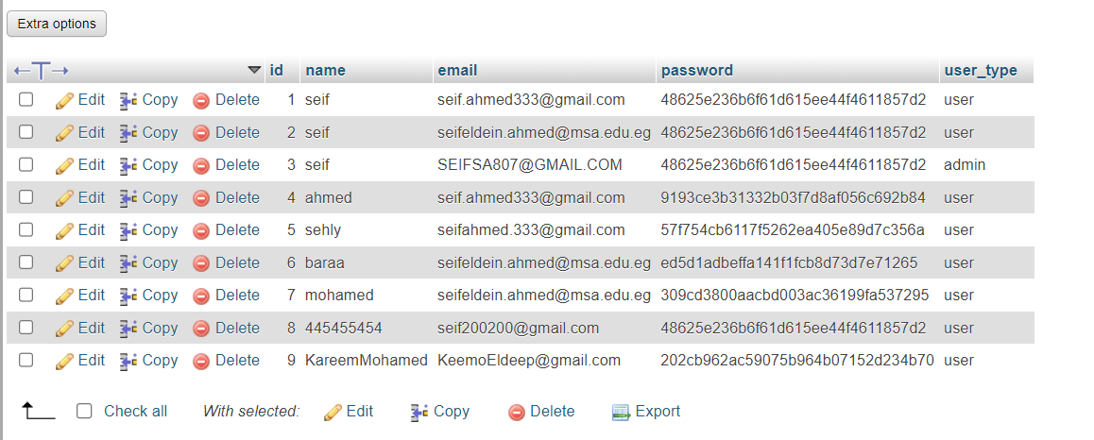
Home Page
Shop
About Us
Register
Cart
Data Base
Overview
User

Slide 19
#Thanks!
Made by
Ahmed Nasreldin Roshdy Sehly
Seif Eldeen Ahmed
Adham Hendawy

